Slide 1
CS 4350: Fundamentals of Software Engineering CS 5500: Foundations of Software Engineering Lesson 3.1 Software Architectures
Jon Bell, John Boyland, Mitch Wand
Khoury College of Computer Sciences
© 2021 Jonathan Bell, John Boyland and Mitch Wand. Released under the CC BY-SA license

Slide 2
Learning Objectives for this Lesson
By the end of this lesson you should be able to:
explain why software architecture is important
list a few of the properties that an architecture may have (the "ilities")
describe the basic ideas of the following architectures, with examples and pictures
monolithic
layered
pipeline
microkernel
event-driven
microservice

Slide 3
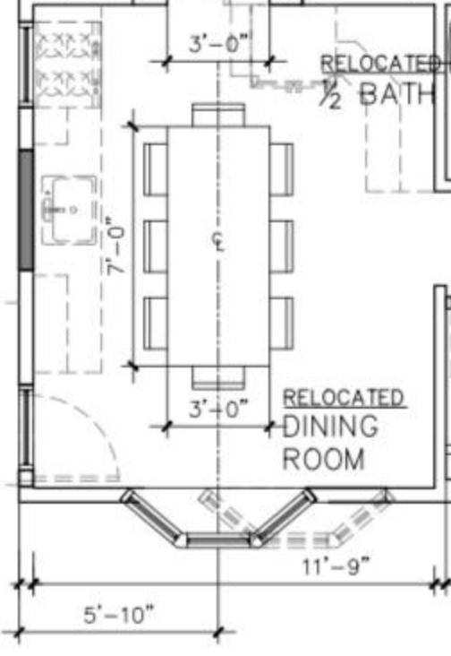
Design in this class so far: the details
Metaphor: building architecture
TodoItem
TodoList
name: string dueDate: date
list: TodoList
*
1
name: string items: TodoItem[]

Slide 4
Design at larger scales
Metaphor: building architecture
How do the pieces fit together? What do we reuse?

Slide 5
Design at larger scales
Metaphor: building architecture
How do the pieces fit together? What do we reuse?
How do we organize into teams?

Slide 6
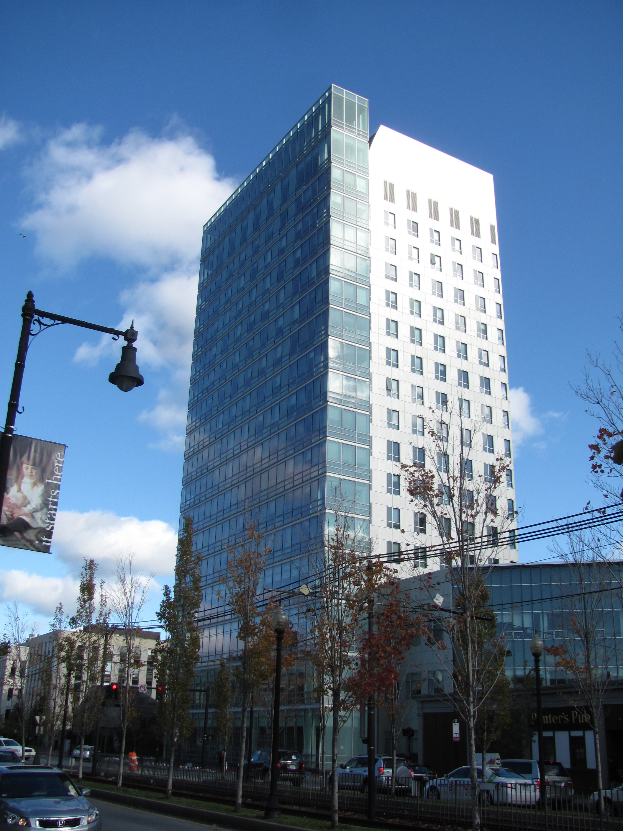

Design at larger scales
How well will our system work in its context?

Slide 7
Goal: Create a high-level model of the system
Abstract details away into reusable components
Allows for analysis of high-level design before implementation
Enables exploration of design alternatives
Reduce risks associated with building the software

Slide 8
Properties of Software Architectures (the "ilities")
Table 4-1. Common operational architecture characteristics
Term | Definition
Availability | How long the system will need to be available (if 24/7, steps need to be in place to allow the system to be up and running quickly in case of any failure).
Continuity | Disaster recovery capability.
Performance | Includes stress testing, peak analysis, analysis of the frequency of functions used, capacity required, and response times. Performance acceptance sometimes requires an exercise of its own, taking months to complete.
Recoverability | Business continuity requirements (e.g., in case of a disaster, how quickly is the system required to be on-line again?). This will affect the backup strategy and requirements for duplicated hardware.
Reliability/safety | Assess if the system needs to be fail-safe, or if it is mission critical in a way that affects lives. If it fails, will it cost the company large sums of money?
Robustness | Ability to handle error and boundary conditions while running if the internet connection goes down or if there’s a power outage or hardware failure.
Scalability | Ability for the system to perform and operate as the number of users or requests increases.
from Richards & Ford: Fundamentals of Software Architecture

Slide 9
More ilities...
Table 4-2. Structural architecture characteristics
Term | Definition
Configurability | Ability for the end users to easily change aspects of the software’s configuration (through usable interfaces).
Extensibility | How important it is to plug new pieces of functionality in.
Installability | Ease of system installation on all necessary platforms.
Leverageability/reuse | Ability to leverage common components across multiple products.
Localization | Support for multiple languages on entry/query screens in data fields; on reports, multibyte character requirements and units of measure or currencies.
Maintainability | How easy it is to apply changes and enhance the system?
Portability | Does the system need to run on more than one platform? (For example, does the frontend need to run against Oracle as well as SAP DB?
Supportability | What level of technical support is needed by the application? What level of logging and other facilities are required to debug errors in the system?
Upgradeability | Ability to easily/quickly upgrade from a previous version of this application/solution to a newer version on servers and clients.
from Richards & Ford: Fundamentals of Software Architecture

Slide 10
And still more ilities
Table 4-3. Cross-cutting architecture characteristics
Term | Definition
Accessibility | Access to all your users, including those with disabilities like colorblindness or hearing loss.
Archivability | Will the data need to be archived or deleted after a period of time? (For example, customer accounts are to be deleted after three months or marked as obsolete and archived to a secondary database for future access.)
Authentication | Security requirements to ensure users are who they say they are.
Authorization | Security requirements to ensure users can access only certain functions within the application (by use case, subsystem, webpage, business rule, field level, etc.).
Legal | What legislative constraints is the system operating in (data protection, Sarbanes Oxley, GDPR, etc.)? What reservation rights does the company require? Any regulations regarding the way the application is to be built or deployed?
Privacy | Ability to hide transactions from internal company employees (encrypted transactions so even DBAs and network architects cannot see them).
Security | Does the data need to be encrypted in the database? Encrypted for network communication between internal systems? What type of authentication needs to be in place for remote user access?
Supportability | What level of technical support is needed by the application? What level of logging and other facilities are required to debug errors in the system?
Usability/achievability | Level of training required for users to achieve their goals with the application/solution. Usability requirements need to be treated as seriously as any other architectural issue.
from Richards & Ford: Fundamentals of Software Architecture

Slide 11
We don't have time to study these in any detail, or to try to discuss how any particular architecture might rate on any of them.
You could write a whole book about that...

Slide 12
Our goal:
Just talk about some different top-level organizations.
Knowing the top-level organization gives you the first clue about
how to understand the system
where to look for bugs or explain behaviors
how to organize into teams
how to find modification and extension points
Remember the overall goal of making software systems understandable by humans.

Slide 13
Architecture #0: Monolithic
A single app, with no particular organization
Also known as: "spaghetti code"
May still have useful interfaces for some degree of encapsulation and modularity.
but is there a method to his madness?
Shakespeare, Hamlet. The exact quote is: "Though this be madness, yet there is method in't" (Polonius, Act 2, Scene 2)
Brian Foote and Joe Yoder

Slide 14
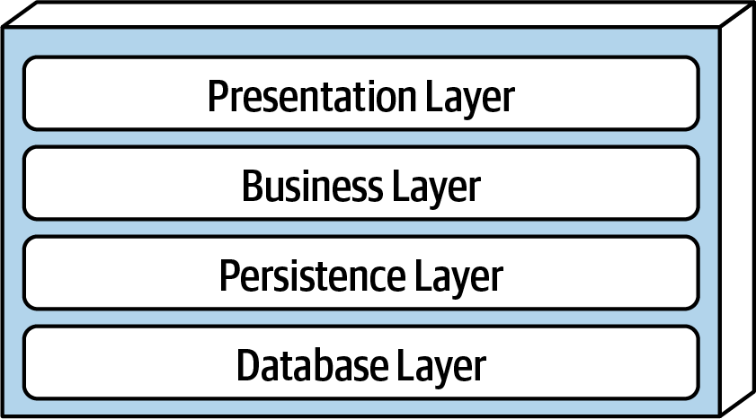
Architecture #1: Layered
Each layer depends on services from the layer or layers below
Organize teams by Layer
different layers require different expertise
When the layers are run on separate pieces of hardware, they are sometimes called "tiers"

Slide 15
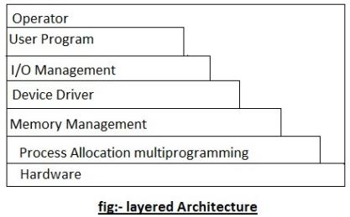
Layered Architecture (contd)
Typical organization for operating systems
Layers communicate through procedure calls and callbacks (sometimes called "up-calls")

Slide 16
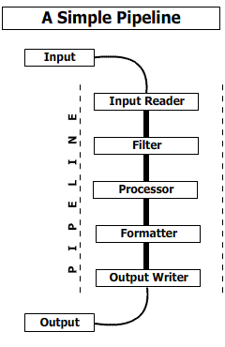
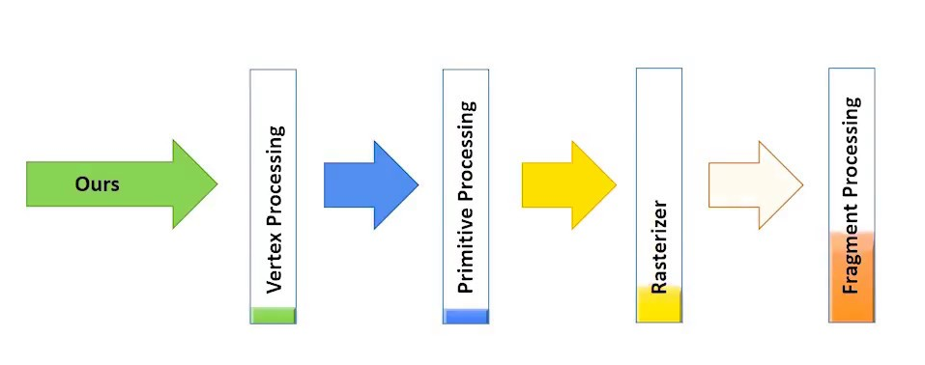
Architecture #2: Pipeline
Good for complex straight-line processes, eg:
image processing

Slide 17
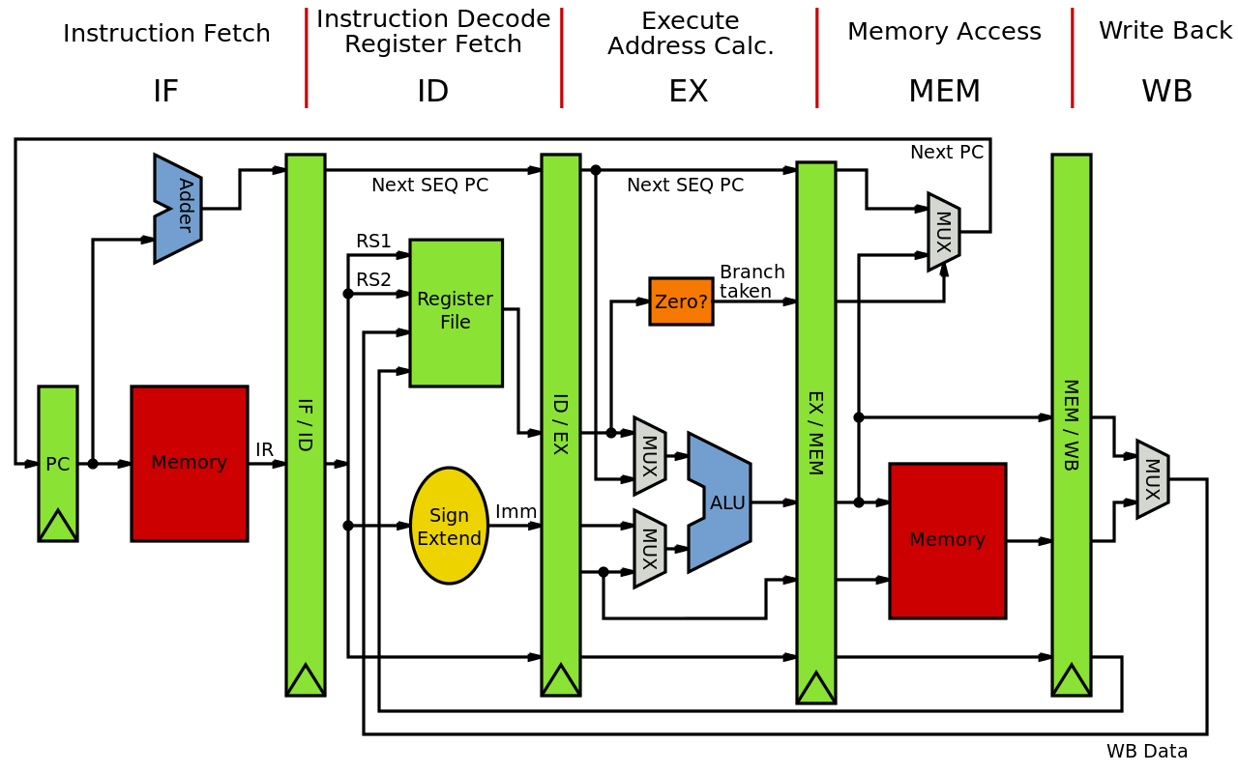
Also good for visualizing hardware

Slide 18
How do the layers communicate?
That's the next-level decision
data-push (each layer invokes the next)
demand-pull (each layer demands data from its processor)
queues? buffers?
??

Slide 19
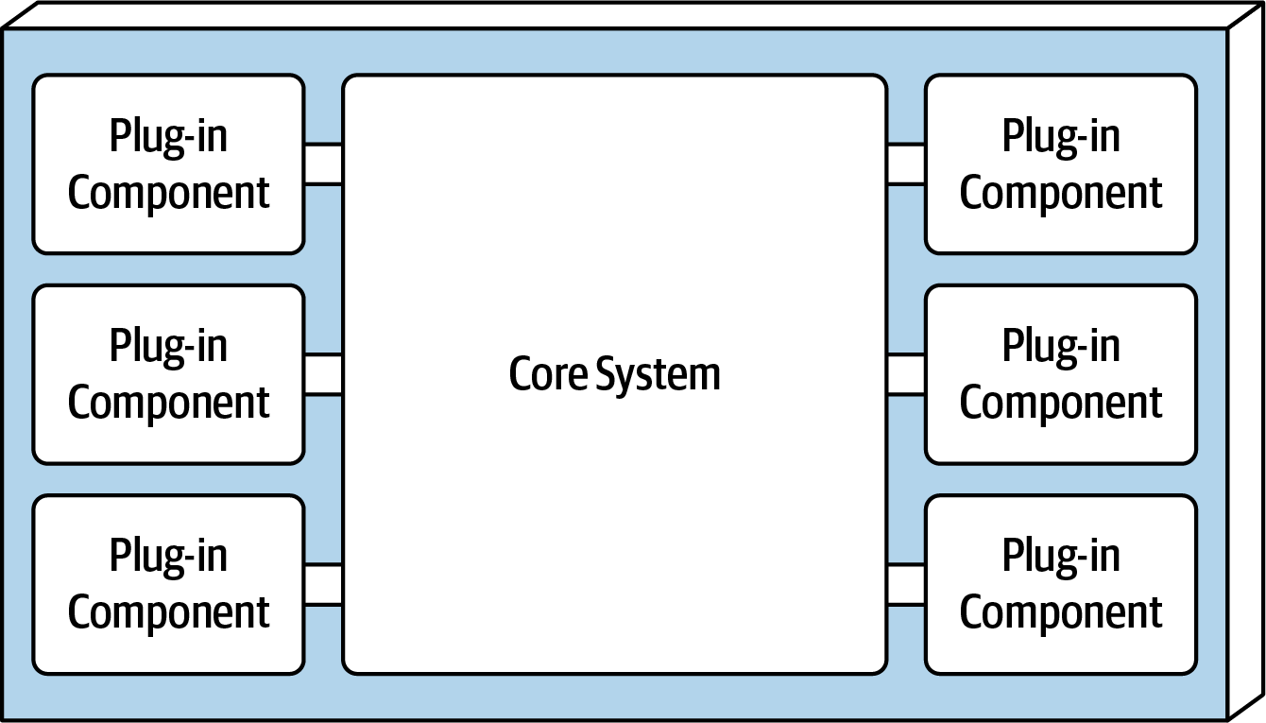
Architecture #3: Microkernel + plugins
System consists of a small core for essential functions, and lots of plugins or hooks to add other services
Highly extensible
Plug-ins can be designed by small, less-experienced teams– even by users!
Connection methods may vary

Slide 20
Microkernel Examples
Many examples:
Visual Studio Code
emacs (emacs-lisp + hooks)
git clients
$ ls .git/hooks
applypatch-msg.sample pre-applypatch.sample pre-rebase.sample
commit-msg.sample pre-commit.sample pre-receive.sample
fsmonitor-watchman.sample prepare-commit-msg.sample update.sample
post-update.sample pre-push.sample

Slide 21
Express.js uses a microkernel architecture
express.js depends on plug-ins:
app.get is a hook that adds a handler to the server. The handlers are ordered (the first matching handler is executed), and can be pipelined, so a handler can invoke another handler if desired.
app.get('/transcripts', (req,res) => {
console.log('Handling GET/transcripts')
let data = db.getAll()
console.log(data)
res.status(200).send(data)
})

Slide 22
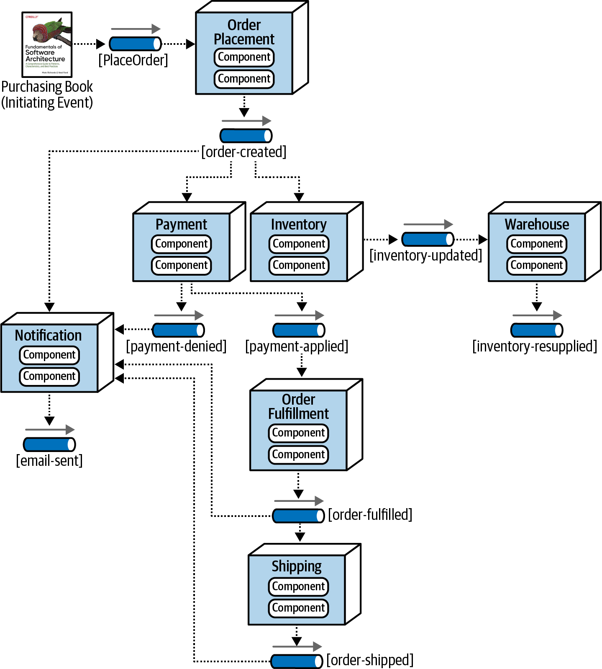
Architecture #4: Event-Driven Architecture
Like pipeline, but more complicated
Each processing unit has an in-box and one or more out-boxes
Each unit takes a task from its inbox, processes it, and puts the results in one or more outboxes.
Stages are typically connected by asynchronous message queues.
Conditional flow

Slide 23
Architecture #5: Microservices
Overall task is divided into different components
Each component is implemented independently
Each component is
independently replaceable,
independently updatable
Components can be built as libraries, but more usually as web services
Services communicate via HTTP, typically REST (see lesson 3.3)

Slide 24
Microservices: Schematic Example
NodeJS, MongoDB
Google Service
Java, MySQL
Mod 1
Mod 2
Mod 3
Todos
Logins
Mailer
REST service
REST service
REST service
Productivity App
Database
Database
Database
Frontend
REST
Search Engine
Analytics
Social Crawler
“Dumb”
App Server
Mod 4
Mod 5
Mod 6
REST service
REST service
REST service
Database
Database
Database
Java, Neo4J
C#, SQLServer
Python, MongoDB

Slide 25
Microservice Advantages and Disadvantages
Advantages
services may scale differently, so can be implemented on hardware appropriate for each (how much cpu, memory, disk, etc?). Ditto for software (OS, implementation language, etc.)
services are independent (yay for interfaces!) so can be developed and deployed independently
Disadvantages
service discovery?
should services have some organization, or are they all equals?
overall system complexity

Slide 26
Microservices are (a) highly scalable and (b) trendy
Microservices at Netflix:
100s of microservices
1000s of daily production changes
10,000s of instances
BUT:
only 10s of operations engineers
https://medium.com/refraction-tech-everything/how-netflix-works-the-hugely-simplified-complex-stuff-that-happens-every-time-you-hit-play-3a40c9be254b

Slide 27
Microservices vs Monoliths
higher is better
Martin Fowler’s Microservices Guide - https://martinfowler.com/microservices/

Slide 28
Review: Learning Objectives for this Lesson
You should now be able to:
explain why software architecture is important
list a few of the properties that an architecture may have (the "ilities")
describe the basic ideas of the following architectures, with examples and pictures
monolithic
layered
pipeline
microkernel
event-driven
microservice

Slide 29
Next steps...
In the remaining lessons of this week, we will learn about http, RESTful protocols, and the express.js, with the goal of building a small but non-trivial REST server in express.js.

